Slide 1
Including scale when analyzing high throughput sequencing datasets (Alternative title: 2010 called and wants their research question back!)
Greg Gloor
ggloor@uwo.ca
@gbgloor
@gbgloor.bluesky.social

Slide 2



Kudos to start
Justin Silverman MD/PhD, Ass’t Professor
College of Information Science and Technology,
Biostatistics, Medicine, Penn State
Michelle Pistner Nixon PhD, Ass’t Res. Professor
College of Information Science and Technology,
Penn State
Andrew Fernandes PhD, Senior Staff Scientist
ShieldAI, San Diego

Slide 3
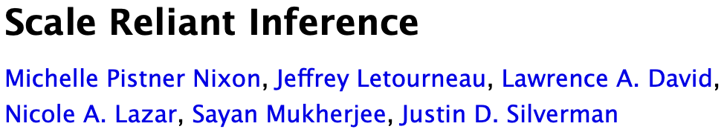

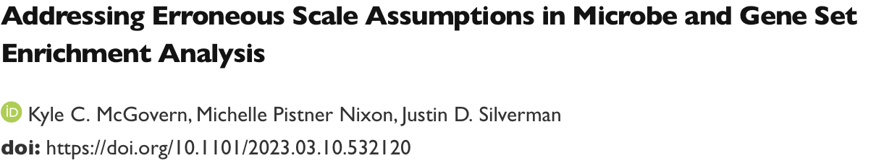

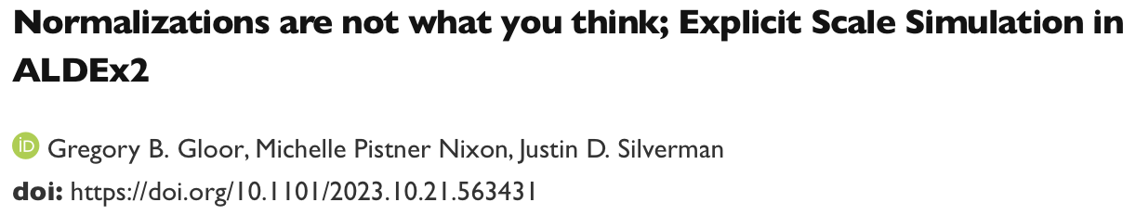
There be papers …
Beyond Normalization: Incorporating Scale Uncertainty in ALDEx2
Michelle Pistner Nixon, Gregory B. Gloor, Justin D. Silverman
Now on V5 of ?

Slide 4
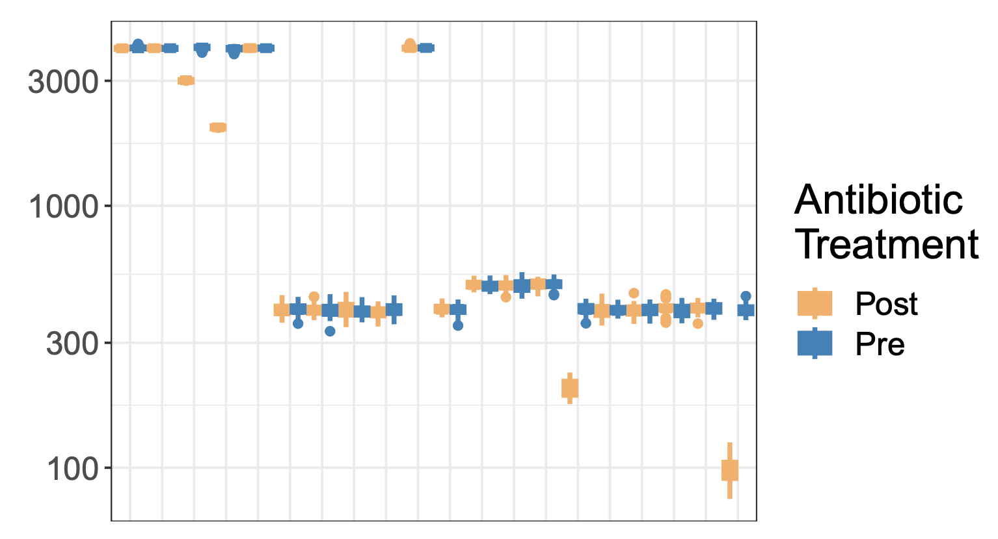
Drivers
‘Bad’ HTS data is shockingly easy to generate
Chemostat experiment
Mis-estimation of scale causes issues for compositional systems
Unacknowledged bias in specifying scale causes commonly observed analysis artefacts

Slide 5
Drivers
‘Bad’ HTS data is shockingly easy to generate
BV v H metatranscriptome dataset
Scale misspecification at play here
H / BV bacterial load ~ 1/10 – 1/100

Slide 6
Generic workflow
Think of the possibilities!

Slide 7
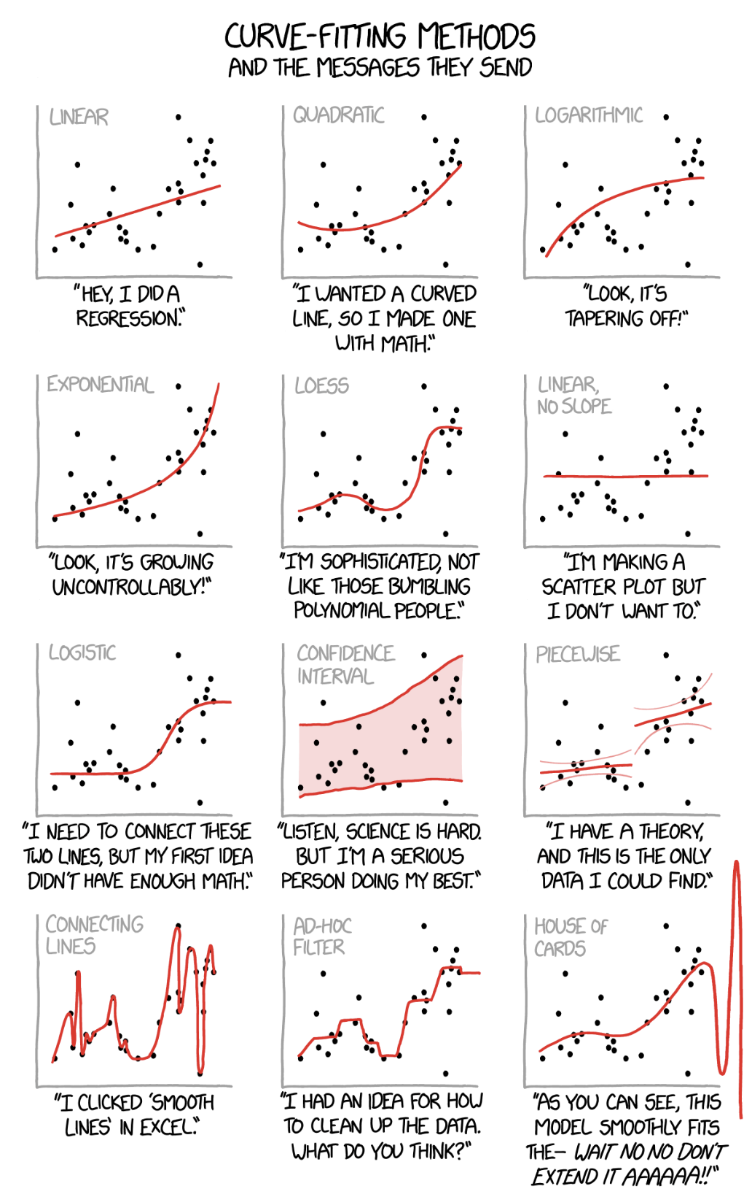
Obligatory XKCD

Slide 8
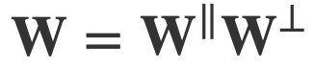
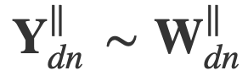
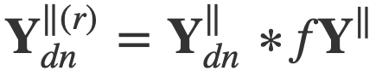
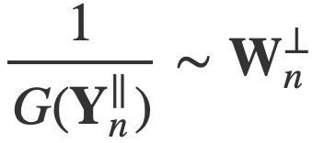
Formally
1
Environment is a D x N matrix W:
Sequencing returns:
All normalizations are ratios:
Interpreting the Geometric mean:
(Michelle/Justin SRI supersets CoDa)

Slide 9

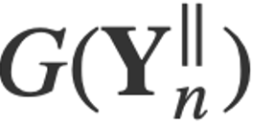
Unacknowledged bias
Both and are single estimates
Nixon/Silverman argue that CODa/ sequencing is a PID and need to build full posterior model
From Gustafson 2015

Slide 10
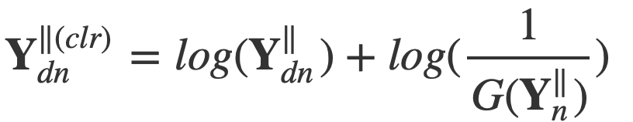
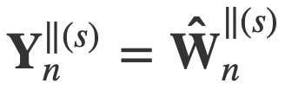
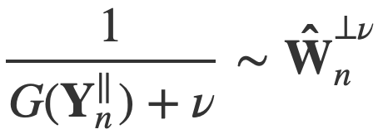
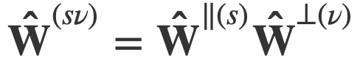
ALDEx2 posterior model
Environment is a D x N matrix W:
The CLR is used by ALDEx2:
ALDEx2 posterior model:
Bayesian scale estimate:
We now have a full posterior model of scale in ALDEx2

Slide 11
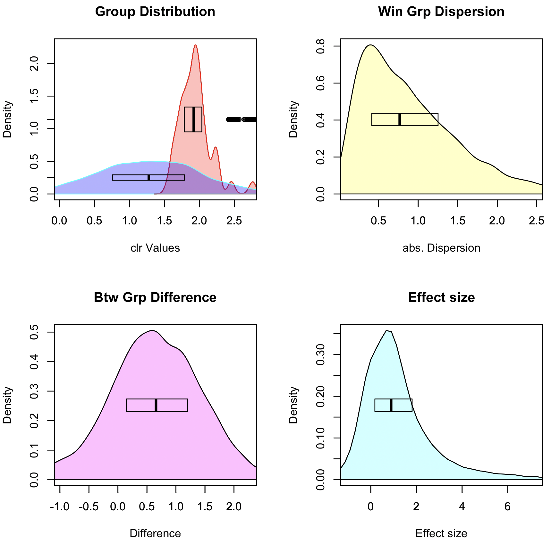
Graphical intuition
Posterior distributions:
rab.A, rab.B
Pooled dispersion: diff.win
Pooled difference: diff.btw
Pooled Effect: effect

Slide 12
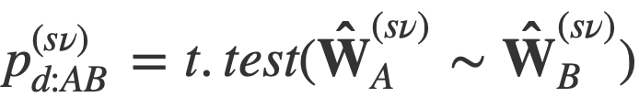
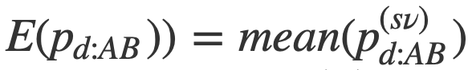
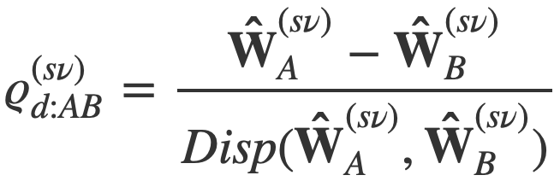
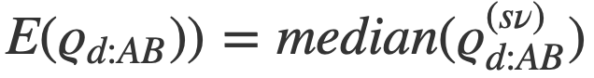
Calculate test statistics
Can calculate posterior test statistic if A=d[1:i], B=d[j,n]:
And then an approximate posterior predicted p-value:
And a posterior effect size:
And reduce to point estimate:

Slide 13
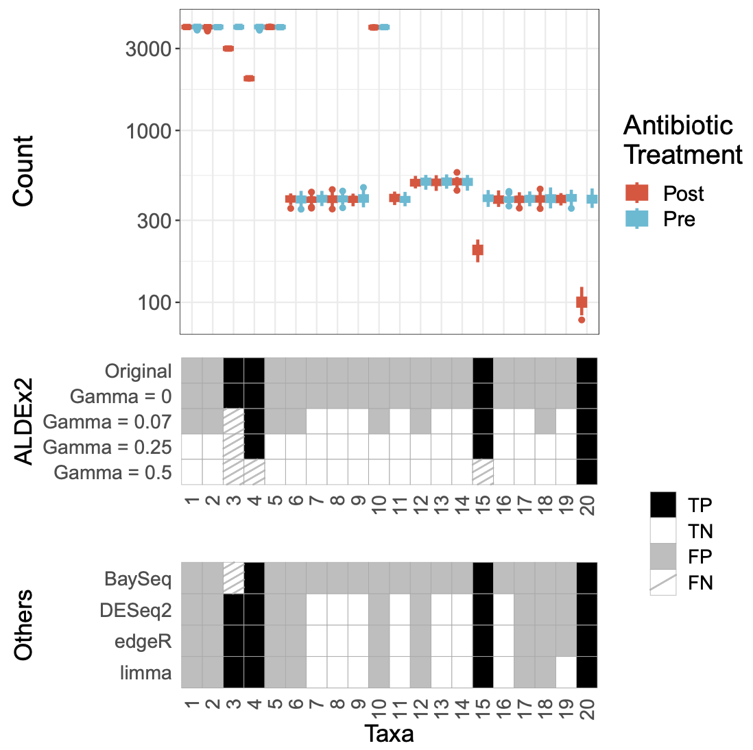
Problem 1: bioreactor
Simulated bioreactor data
High FP rate across the board
Data are asymmetric
Adding scale removes FP

Slide 14
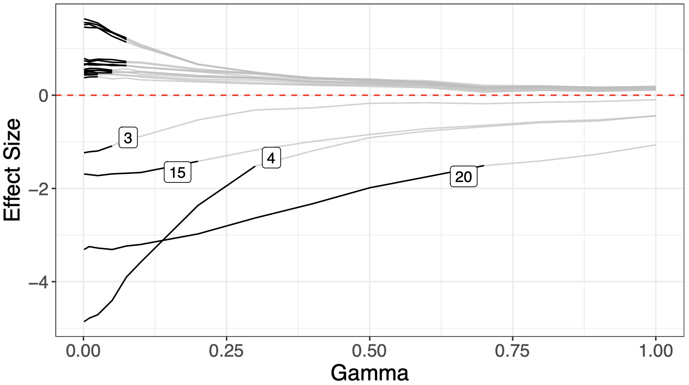
Problem 1: bioreactor
Simulated bioreactor data
High FP rate across the board
Data are asymmetric
Adding scale removes FP
Sensitivity analysis can help find scale settings

Slide 15
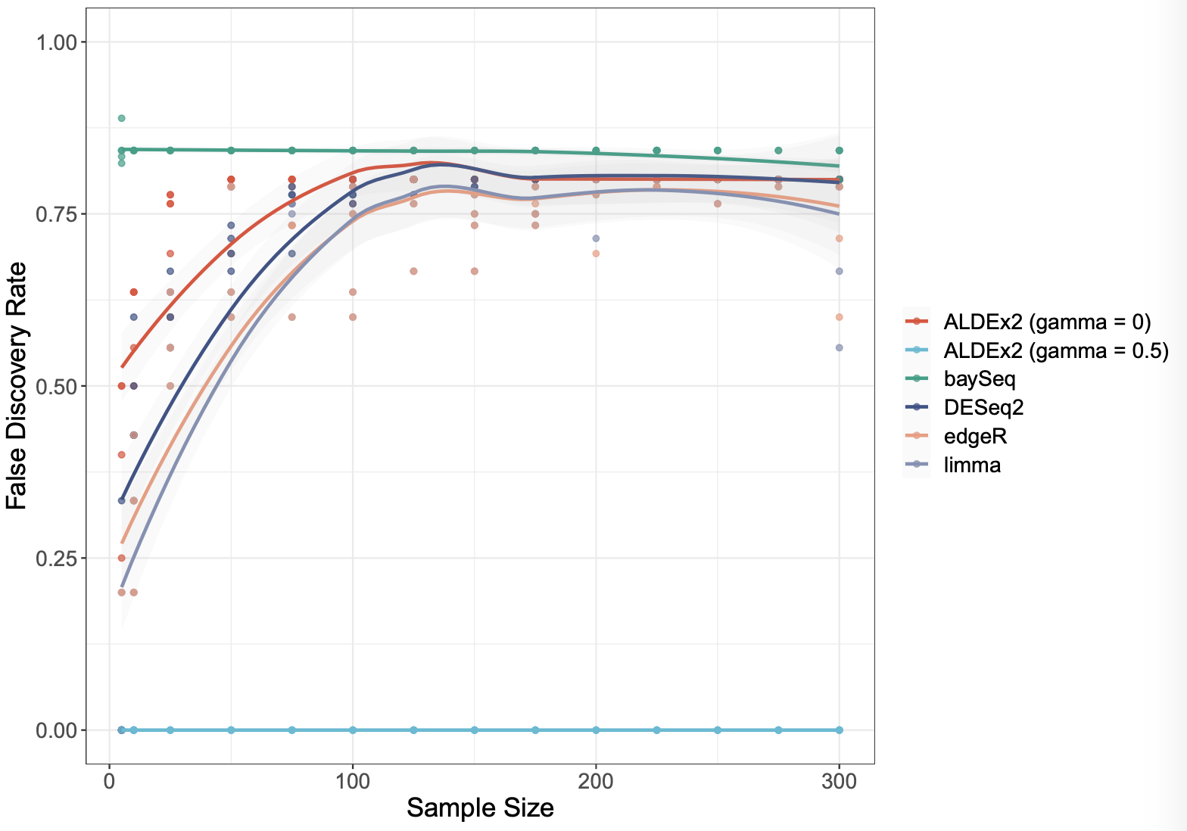
Problem 1: bioreactor
Simulated bioreactor data
High FP rate across the board
Data are asymmetric
Adding scale removes FP
Sensitivity analysis can help find scale settings
Increasing sample size makes problem worse for all tools but the scaled model

Slide 16
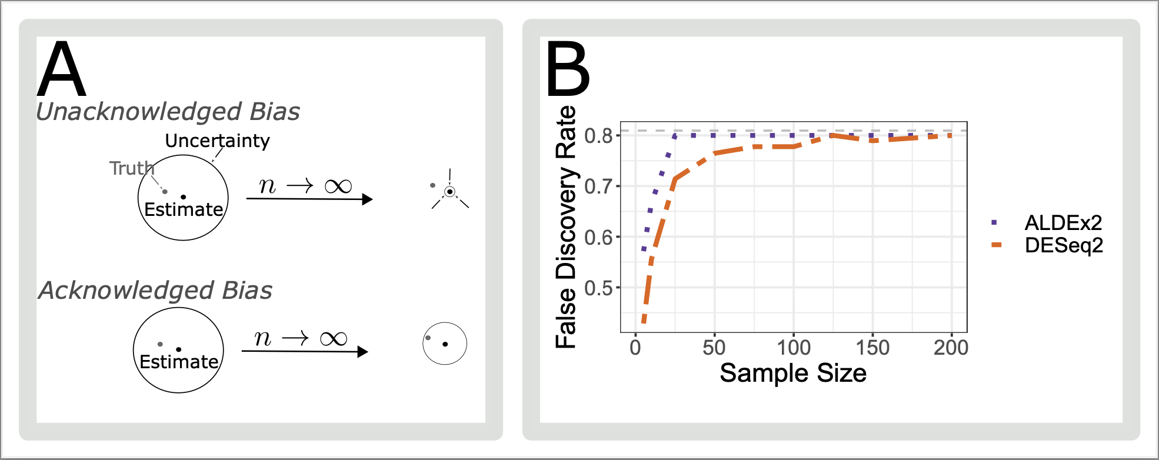
Because - unacknowledged bias

Slide 17
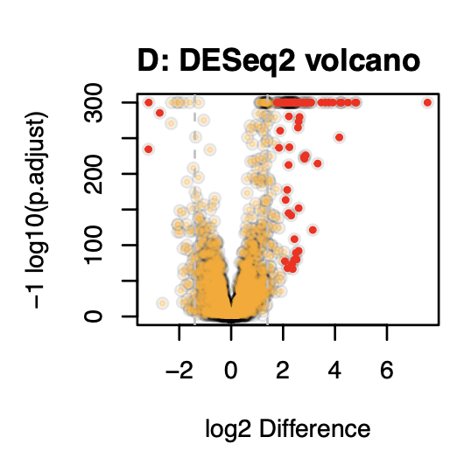
Problem 2: overpowering
Observation that too much data is counterproductive (Schurch)
In a highly replicated RNA-seq experiment over 70% of transcripts are DA
Biologically implausible
Breaks assumption of normalization (RLE)
Dual cutoff solution

Slide 18
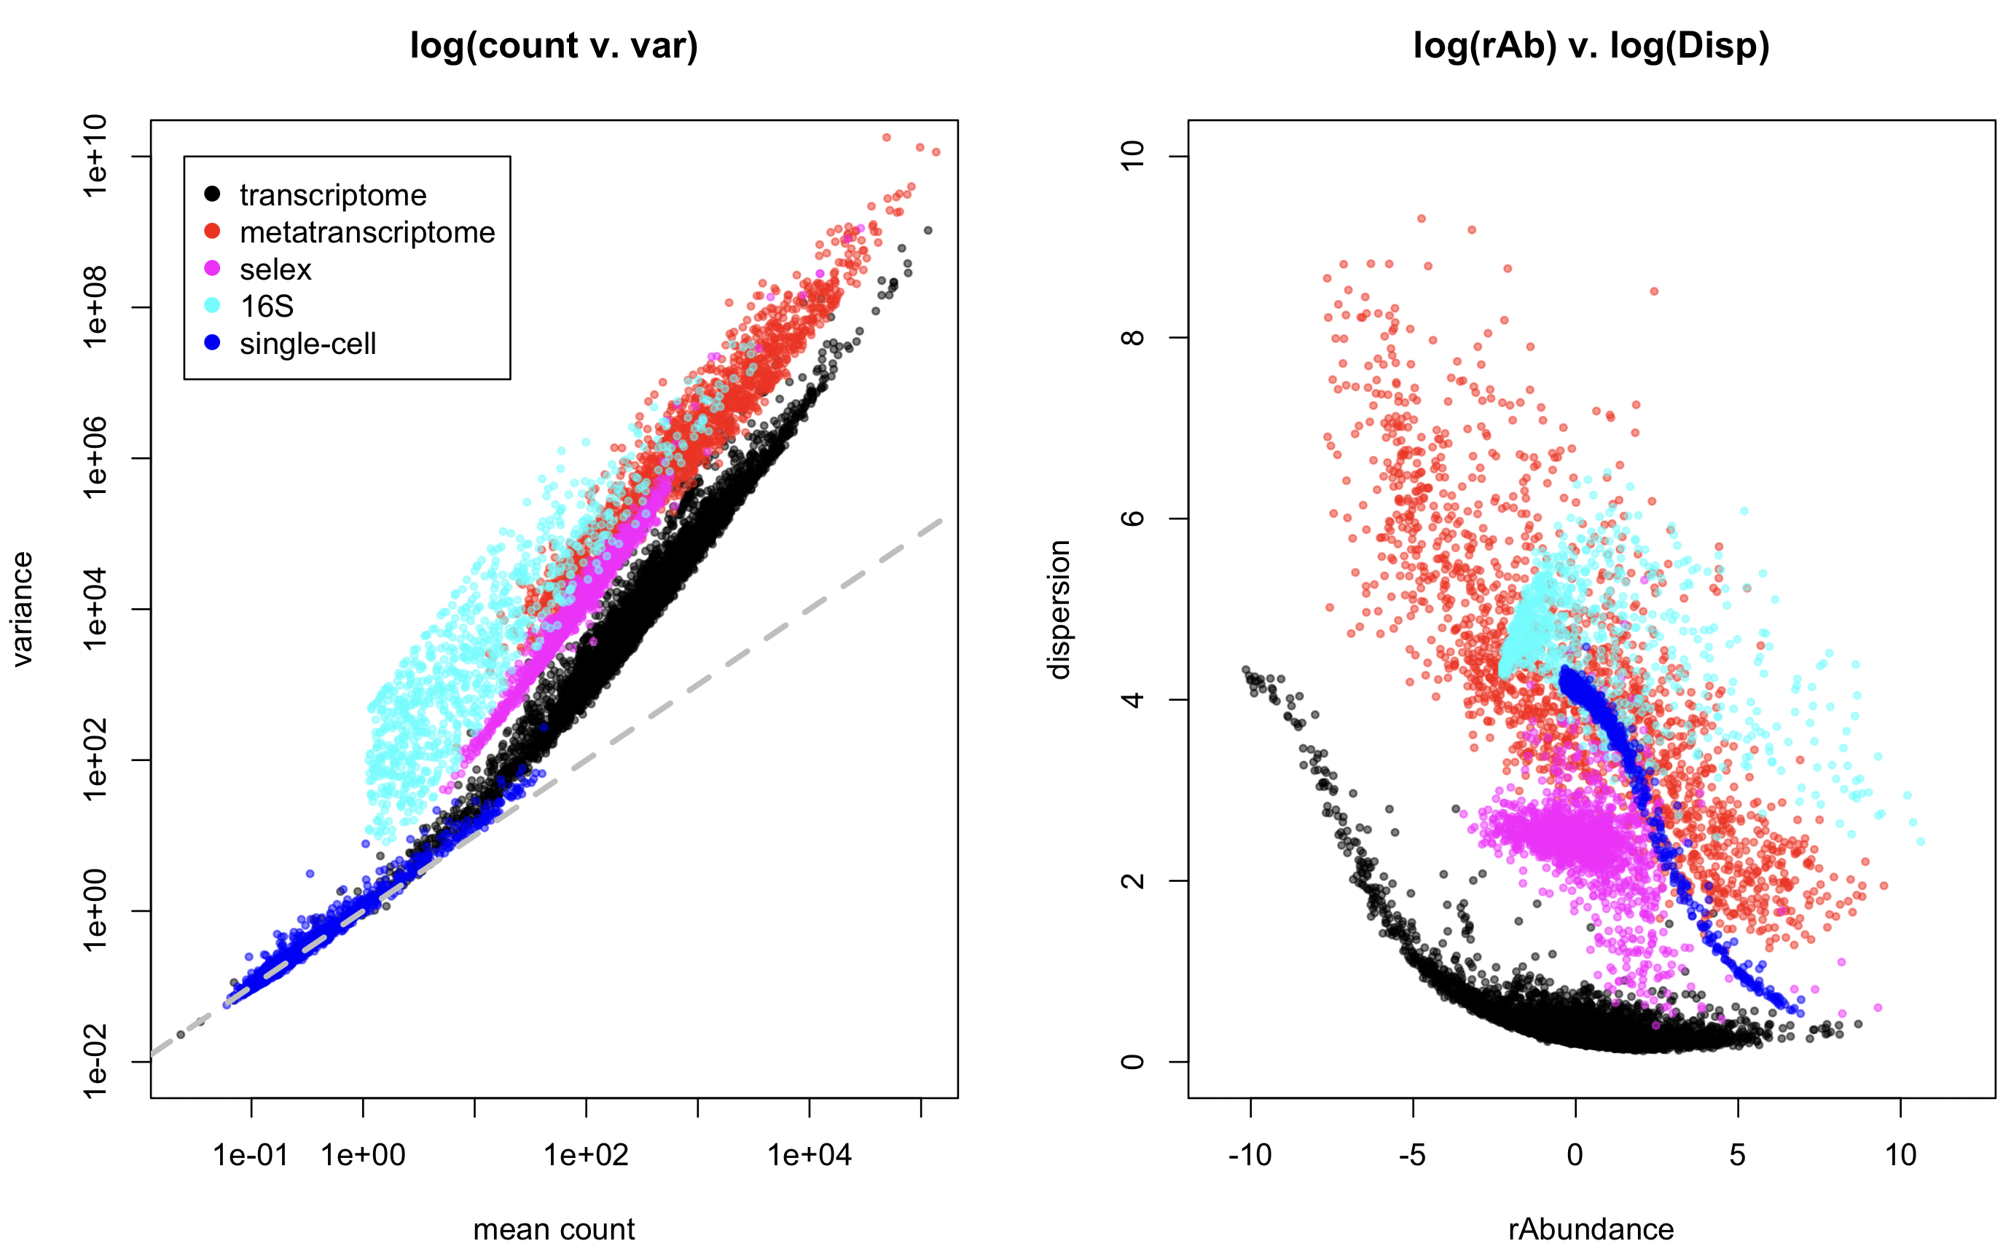
All data are NB, but …

Slide 19
Low dispersion is the issue

Slide 20
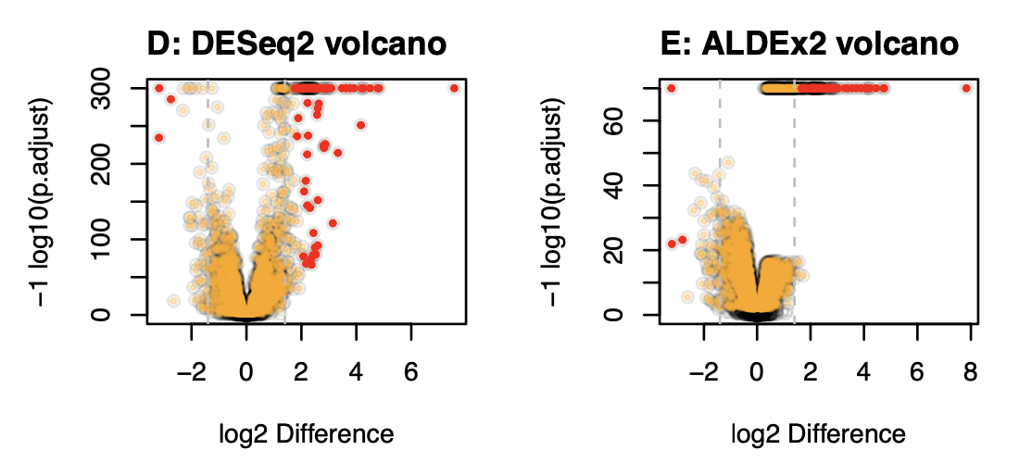
Overpowering is normalization independent

Slide 21
Adding scale uncertainty …

Slide 22
Adding scale uncertainty …

Slide 23
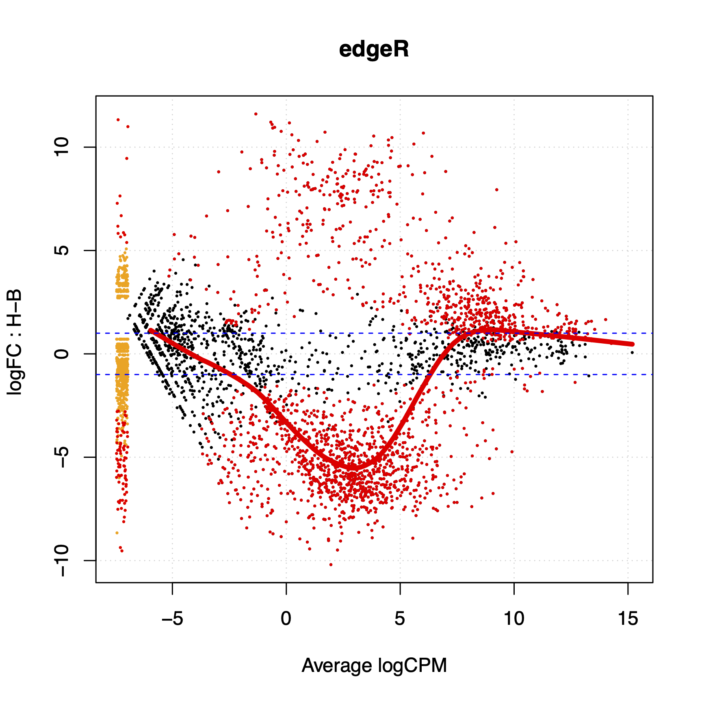
What about my problem?
Scale can be added on a per-group or per-sample basis
Differential scale changes the location of the data
This depends only on the ratio of the scales, not on the value of the scales
Yes, the normalization value is irrelevant but the ratio between the values for different groups is important

Slide 24
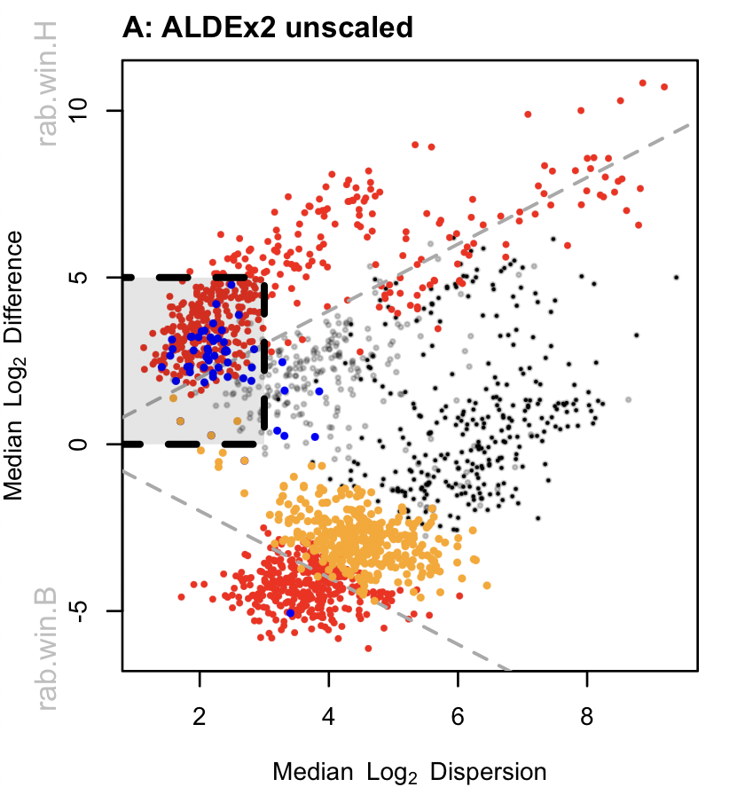
Meta-transcriptomes …
Effect plot
Bit of a mess
Housekeeping genes not centered
HK FP boxed (rRNA, Tsc’n, Gly …)
False negatives not significant
Gamma=NULL

Slide 25
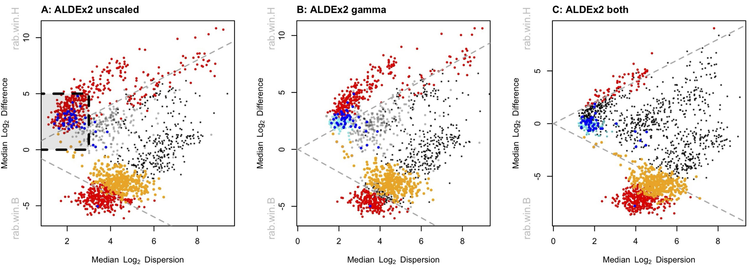
Meta-transcriptomes …
Gamma=NULL
Gamma=0.5
Ratio = 1 : 1
Gamma=0.5
Ratio = 1 : 1.15

Slide 26
Meta-transcriptomes …
CAMP resistance
Metabolism stuff
Nitrogen/Amine metabolism
Gamma=0.5
Ratio = 1 : 1.15

Slide 27
Summary
HTS data are a form of partially identifiable data
Scale is assumed, wrongly, by all tools to be estimated properly
Accounting for scale prevents shrinking to a known wrong estimate
Better inference is obtained if all parameters are estimated including scale
As a minimum can determine what is robust to scale uncertainty
Uncertainty is not a bad thing ifyou remember
A – your data are uncertain
B – therefore the results are uncertain
C – therefore your interpretation must allow for uncertainty
D – uncertainty and skepticism should be your default state

Slide 28
Summary
HTS data are a form of partially identifiable data
Scale is assumed, wrongly, by all tools to be estimated properly
Accounting for scale prevents shrinking to a known wrong estimate
Better inference is obtained if all parameters are estimated including scale
As a minimum can determine what is robust to scale uncertainty
Uncertainty is not a bad thing if you remember
A – your data are uncertain
B – therefore the results are uncertain
C – therefore your interpretation must allow for uncertainty
D – uncertainty and skepticism should be your default state

